Slide 1

Maximizing Flaming Gorge Dam Releases to Lake Powell
Notes:
woot

Slide 2
Presentation Overview
Introduction
Brief Description Flaming Gorge Dam Operations
Operations & System Simplification
Model Formulation
Remaining work

Slide 3
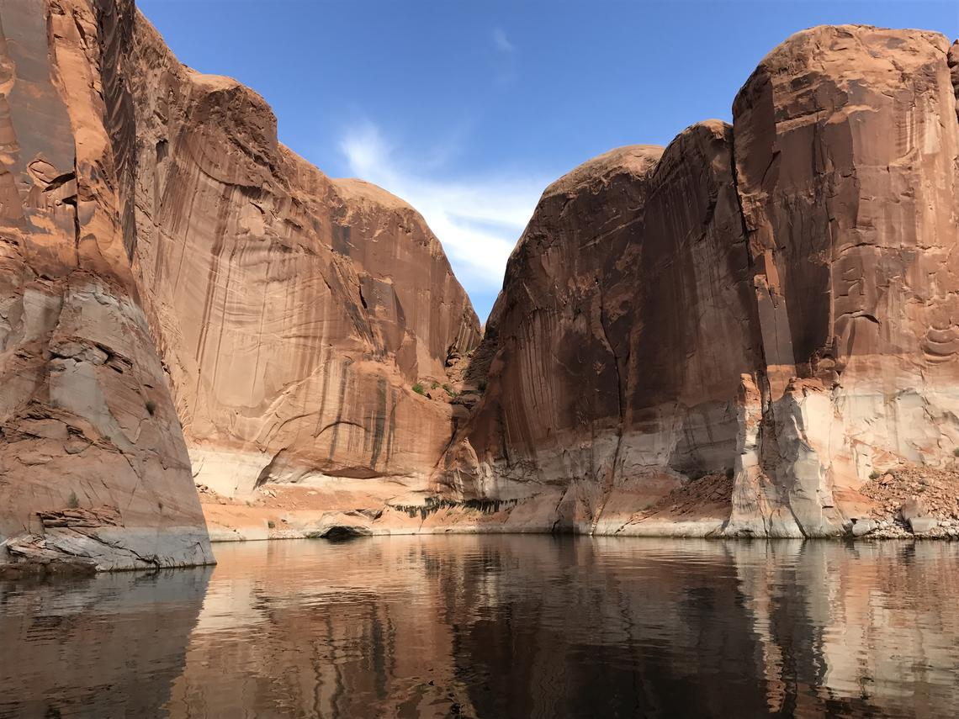
Photo Credit: Wayne Baldwin. Public domain.
Notes:
~The Colorado river basin is one of the most heavily managed bodies of water on earth and millions of people rely on it to meet their water needs
~Due to on going drought, Lake Powell has had its water level drop significantly, which has stressed the ability of Glen Canyon Dam operators to meet water and hydropower demands.
~A potential way to mitigate this problem is to maximize releases from Flaming Gorge Dam, bolstering the downstream flows of the Green River which eventually reach Lake Powell. So the big picture view of my project is trying to model Flaming Gorge Dam Operations to try to identify the tradeoffs between satisfying different Flaming Gorge Management objectives to various degrees and maximizing releases to Lake Powell (next slide)

Slide 4

Flaming Gorge Management Objectives
Hydropower:
Flood Control:
Water storage/supply:
Two Different Environmental Flow Releases:
My imposed objective of Maximizing Releases to Lake Powell:
$${FG}_{max}≤ \sum{X\left(FlowOut,Time\right) }$$
$$X\left( Storage, Time\right)≥MinReservoirVol ∀ Time, _X\left( FlowOut, Time\right)≥HydroFlow(Time) ∀ Time$$
$$X\left( Storage, Time\right)≤MaxReservoirVol ∀ Time,$$
$$X\left(FlowOut, Time\right)≥D.S.Demand/BaseFlow(Time) ∀ Time$$
$${LTRP}_{max}= \sum{I_{LTRP}\left(Year\right) ,{ CP}_{max}= \sum{I_{CP}\left(Year\right) }}$$
Notes:
Alright so I decided to try to model 5 different Flaming Gorge Reservoir Management objectives in addition to my imposed objective of maximizing releases to Lake Powell.
~We’ve got Hydropower which I modeled using a minimum reservoir storage constraint and outflow meeting or exceeding hydropower demand for a given time period constraint.
~We’ve got Flood Control which I modeled using a maximum reservoir storage constraint
~We’ve got Water storage and supply which I modeled using a minimum reservoir storage constraint similar to my hydropower storage constraint and as an outflow meeting or exceeding d.s. demands/baseflow constraint
~We’ve got two different environmental flow releases which I tried model as objective functions of maximizing the number of years these flows are met.
~Finally we’ve got my imposed objective of maximizing Flaming Gorge Releases to Lake Powell which I modeled using a summative outflow constraint over the 5 year period my model is addressing
~One of the more complicated aspects of Flaming Gorge operations is meeting Environmental flow releases (next slide).

Slide 5
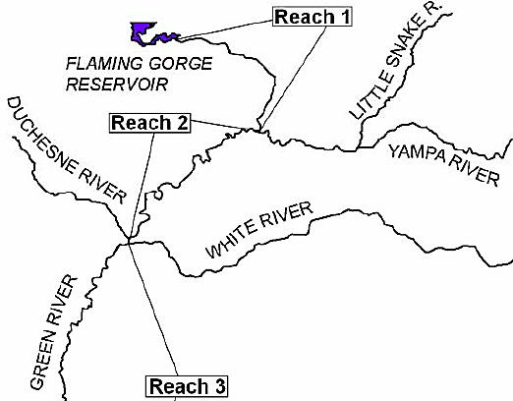

Constraints: Management Objectives
ENDANGERED
Upper Colorado River Endangered Fish Recovery Program (2000, 2007)
Notes:
~Each year Flaming Gorge operators attempt to meet 2 different environmental release flows in Reach 2 of the Green River in an effort to increase endangered native fish recruitment…(point out Reach 2, stress Yampa River)
~These environmental release flows are: the Larval Trigger Release Plan (or LTRP) flows, and the Colorado Pikeminnow summer base flow experiment flows
~The exact timing of these releases varies depending on when the fish are detected at key monitoring locations. However in general the LTRP flows occur in late may or early June, which I simplified to just be the beginning of June in my model, and the Colorado Pike Minnow flows generally occur from the start of July to the end of September.
~The magnitude of these environmental releases also varies depending on the changing flow rate of the Yampa river, and how much water dam managers determine Flaming Gorge can afford to release. The size of these releases are varied continuously based on flows observed downstream at Jensen Utah in Reach 2. This turns out to be a huge pain to model which brings me to my next topic, of how I simplified some of these management objectives and the system itself in my model.

Slide 6
Operations & System Simplification
Easy
Flood Control = Maximum Reservoir Storage Volume
Water storage= Minimum Reservoir Storage Volume
Difficult
Hydropower and Environmental flow releases that fluctuate hourly or daily.
Random nature of hydrologic inputs to Flaming Gorge Reservoir and the Yampa River in Reach 2
Unspecified release volumes from Flaming Gorge Dam to meet Environmental flows
Notes:
~ As we already talked about flood control and water storage were easy to model
~Regarding the time varying nature of Hydropower releases, Environmental flows, and hydrologic inputs, I had to get a bit more creative. Also before I go further, it is important to note that I wanted my model to use monthly time steps so I needed all of my constraints and inflows to be in total monthly flow volumes.

Slide 7
Monthly Hydropower Release Volumes
Month | Hydropower (Ac-ft)
Jan | 110063
Feb | 108932
Mar | 50745
April | 49732
May | 51806
June | 124661
July | 89708
Aug | 108694
Sep | 98434
Oct | 63808
Nov | 77209
Dec | 105989
Notes:
~Regarding hydropower releases I examined 5 years of historical hydropower release flow rates and used the minimum total monthly hydropower flows from each year as my monthly hydropower release constraint values

Slide 8
Annual Mean Flow Rates (2006-2019)
Notes:
~Regarding the random nature of my hydrologic inputs to Flaming Gorge Reservoir and the Yampa River I decided to use 3 different hydrologic scenarios representing dry, average, and wet years. These scenarios were based on historical data from USGS streamflow gages located upstream of Flaming Gorge Reservoir, on the Yampa River near its confluence with the Green River, and on the Green River in Reach 2. I examined annual mean flow rates of 14 years of data and determined years that I felt fell into the categories of dry, average, and wet. I also subtracted the Yampa River flow rates from the Reach 2 Green River flow rates as a way to get at Flaming Gorge Dam releases. I then used the total monthly flow volume of Flaming Gorge Dam releases in June from each hydrologic scenario as my targeted LTRP release volumes for dry, average, and wet years.

Slide 9
Monthly Baseflow & Enviro Release Volumes
2013 Dry Scenario
2014 Average Scenario
2017 Wet Scenario
Month | R1 (Acft/M)
January | 61,488
Febuary | 55,537
March | 49,190
April | 47,603
May | 50,579
June | ---
July | 98,380
August | 98,380
September | 95,207
October | 52,264
November | 50,579
December | 61,488
Total | 887,841
Month | R1 (Acft/M)
January | 61,488
Febuary | 55,537
March | 49,190
April | 47,603
May | 50,579
June | ---
July | 98,380
August | 98,380
September | 95,207
October | 52,264
November | 50,579
December | 61,488
Total | 1,008,317
Month | R1 (Acft/M)
January | 61,488
Febuary | 55,537
March | 49,190
April | 47,603
May | 50,579
June | ---
July | 98,380
August | 98,380
September | 95,207
October | 52,264
November | 50,579
December | 61,488
Total | 1,194,347
June LTRP | 167,147
June LTRP | 287,623
June LTRP | 473,653
Notes:
Next using hydrology dependent estimated average release volumes from the official 2020 to 2021 Flaming Gorge Operations Plan, I determined Flaming Gorge Dam Colorado Pikeminnow release volumes for July though September for each of my hydrologic scenarios. These were low enough that I just lumped them in with my baseflow constraint flow volumes. Speaking of which, I also used the 2020 to 2021 Flaming Gorge Operations Plan to determine baseflow release volumes for months of the year without environmental release objectives. So to recap at this point I have simplified reservoir operations and the system itself into maximum and minimum storage volumes constraints, total monthly release volume requirements for hydropower, and 3 different hydrologic scenarios where I have the total monthly flow volumes of inflows to Flaming Gorge Reservoir, baseflow releases for every month of the year which also include Colorado Pike Minnow environmental release flows, and finally a LTRP environmental release volume for the month of June. So at this point I don’t need to model the Yampa River and Reach 2 and I can focus on modeling Flaming Gorge Dam storage, and inflow and release volumes.

Slide 10

Model Formulation
Decision Variables: $X(FlowOut, Month, Year)$, $X\left(Storage, Month, Year\right)$, $I_{LTRP}\left(Year\right)$.
Objective Function: Maximize ${\#LTRP}_{Max}= \sum{I_{LTRP}\left(Year\right) }$
Constraints:
$X\left( Storage, Month, Year\right)≥MinReservoirVol ∀ months \& years$
$X\left( Storage, Month,Year\right)≤MaxReservoirVol ∀ months \& years,$
$X\left( FlowOut, Month, Year\right)≥HydroFlow\left(Month, Year\right) ∀ months \& years$
$\left( FlowOut, Month, Year\right)≥BaseFlow\left(Month, Year\right) ∀ months \& years$
$\sum{X\left(FlowOut,Month, Year\right) ≥}$ ${FG}_{max}$
$\begin{aligned}X\left( FlowOut, Month, Year\right)≤Release Capacity ∀ months &&&&&&&&&&&&&\&^{\%}\#years\end{aligned}$
$\begin{aligned}Binary Variable \end{aligned}I_{LTRP}\left(Year\right)$ must equal 0 or 1$∀ years$
$X\left( FlowOut, JUNE, Year\right)$ $≥LTRPFlow\left(Year\right)∗I_{LTRP}\left(Year\right) ∀ Years$
$X\left(Storage, Month, Year\right)=X\left(Inflow, Month, Year\right)+X\left(Storage,Month−1, Year\right)−X\left(FlowOut, Time\right) ∀ months \& years$
Notes:
~Alright so at this point we are familiar with my decision variables which are the amount of water to release from Flaming Gorge Dam in a given timestep, the amount of storage to maintain in the reservoir for a given time step, and a binary decision variable of whether or not to participate in LTRP flows for a given year.
~As I’ve already discussed I turned many of the flaming gorge management objectives and my imposed releases to Lake Powel objective into constraints. So right now in my model I only have one objective function which is to maximize the number of years LTRP flows are met.
~Finally regarding my constraints I have the ones I already talked about which are slight changed here to have month and year dimensions. I did this because I wanted to be able to swap out constraint values on a monthly or yearly basis to reflect different hydrologic scenarios. I also have the additional constraints that Flaming Gorge cannot release more flow in a given month than it has outlet capacity to do so, the obvious binary value constraint on ILTRP, The June environmental release constraint that when ILTRP is 1 the model must meet LTRP flows, and finally my conservation of mass constraint for flaming gorge reservoir. In which I’d like to point out that I am neglecting evaporation for now…

Slide 11
Remaining Work
Get model running, which may require reducing baseflow, and hydropower release constraints in certain months.
Identify a range of feasible Total Flaming Gorge Releases constraints. Which falls into the broader category of me still needing to accomplish what I set out to do which is to identify the tradeoffs between satisfying different Flaming Gorge Management objectives to various degrees and maximizing releases to Lake Powell

Slide 12
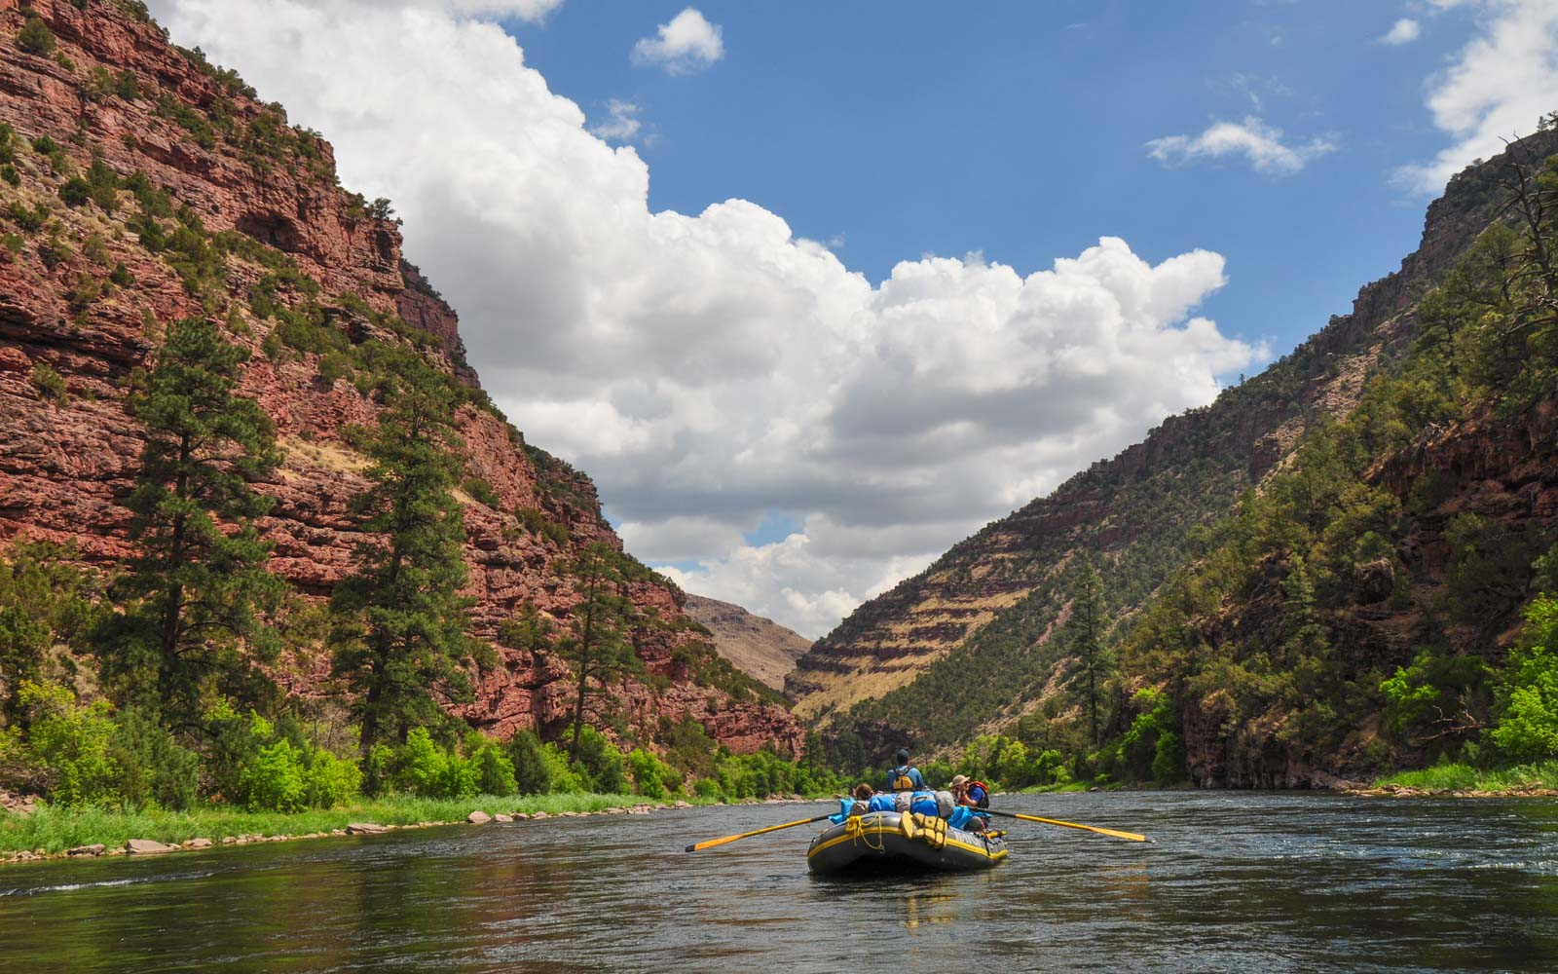
Notes:
Questions?

Slide 13
References
Upper Colorado River Endangered Fish Recovery Program (2000). Flow and Temperature Recommendations for Endangered Fishes in the Green River Downstream of Flaming Gorge Dam. Retrieved from: https://www.coloradoriverrecovery.org/documents-publications/technical-reports/isf/flaminggorgeflowrecs.pdf
U. S. Bureau of Reclamation. (2006) Record of Decision Operation of Flaming Gorge Dam Final Environmental Impact Statement. Retrieved from: https://www.usbr.gov/uc/envdocs/rod/fgFEIS/final-ROD-15feb06.pdf
U. S. Bureau of Reclamation. (2020) Flaming Gorge Operation Plan – May 2020 through April 2021 Retrieved from: https://www.usbr.gov/uc/DocLibrary/Plans/FlamingGorge/20200430-FlamingGorgeOperationPlan-May2020-April2021-508-PO.pdf
U. S. Bureau of Reclamation. (2020) Upper Colorado Region Water Operations: Historic Data. Retrieved from: https://www.usbr.gov/rsvrWater/HistoricalApp.html
U.S. Geological Survey (2020). USGS 09224700 BLACKS FORK NEAR LITTLE AMERICA, WY. National Water Information System data available on the World Wide Web (USGS Water Data for the Nation), accessed [November 27, 2020], at [https://waterdata.usgs.gov/wy/nwis/uv?09224700].
U.S. Geological Survey (2020). USGS 09217000 GREEN RIVER NEAR GREEN RIVER, WY. National Water.Information System data available on the World Wide Web (USGS Water Data for the Nation), accessed [November 27, 2020], at [https://waterdata.usgs.gov/wy/nwis/uv?09217000].
U.S. Geological Survey (2020). HENRYS FORK NEAR MANILA, UT. National WaterInformation System data available on the World Wide Web (USGS Water Data for the Nation), accessed [November 27, 2020], at URL [https://waterdata.usgs.gov/wy/nwis/uv?09229500].
U.S. Geological Survey (2020). USGS 09260050 YAMPA RIVER AT DEERLODGE PARK, CO. National Water Information System data available on the World Wide Web (USGS Water Data for the Nation), accessed [November 27, 2020], at URL [https://waterdata.usgs.gov/usa/nwis/uv?site_no=09260050].

